Slide 1
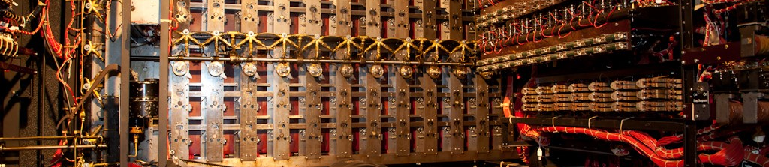
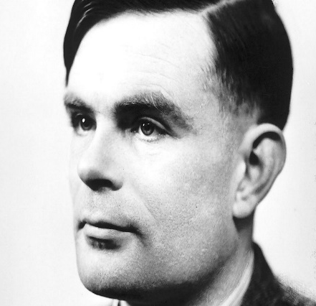
Alan Turing and Enigma Machine
MACHINE LEARNING
World War Two Hero
Notes:
1 - Josi

Slide 2

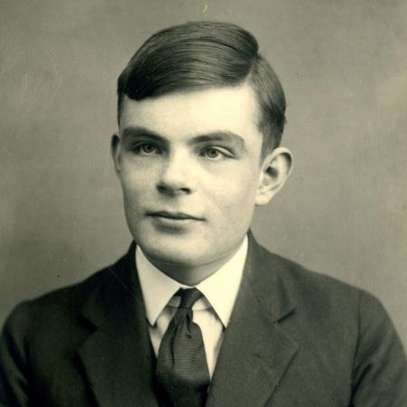

Introduction:
Alan Turing was born in 1912, in Paddington, central region in London, England.
England in a convent
Period
Notes:
2 - Josi

Slide 3

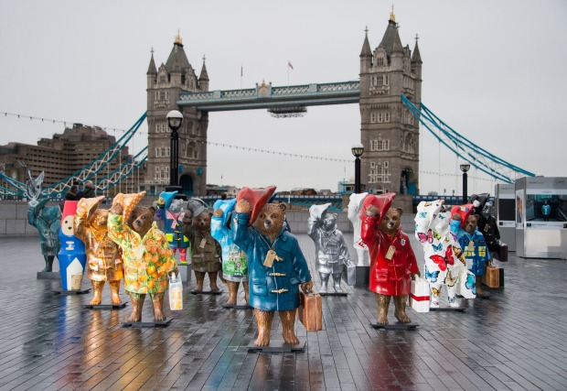


Paddington City

Slide 4

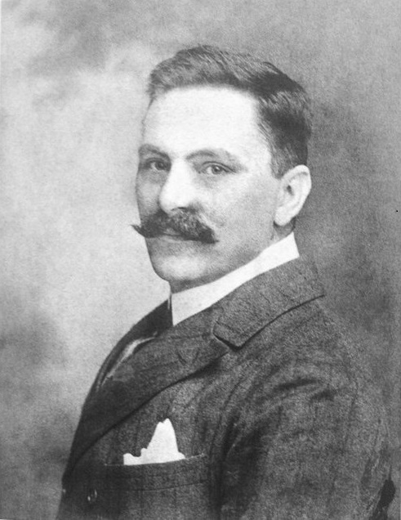
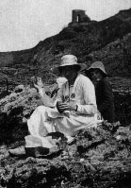
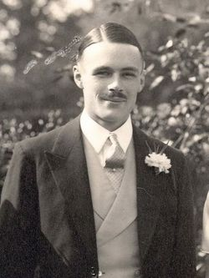
Julius Mathison Turing
Ethel Sara Stoney
John Turing
Notes:
1 - Paty

Slide 5

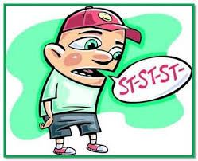

Stuttering:
Stuttering - gagueira
Notes:
1 - Marcos

Slide 6
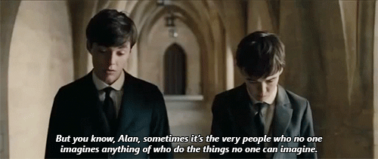
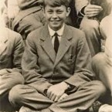
Get a modern PowerPoint Presentation that is beautifully designed. I hope and I believe that this Template will your Time.
Movie: Imitation Game
Christopher Morcom
Notes:
2 - Paty

Slide 7
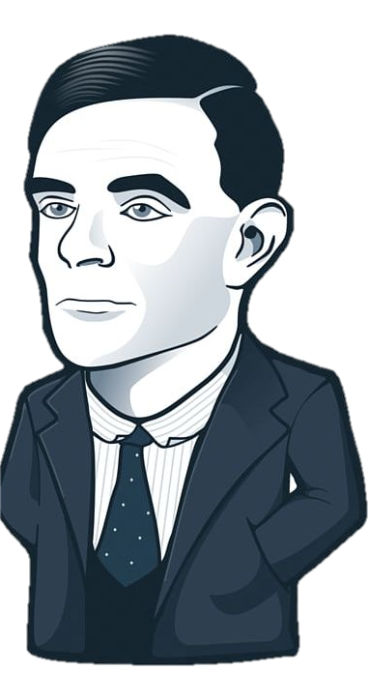
Degree:
Mathematician
Computer science
Notes:
3 – Marcos/paty

Slide 8
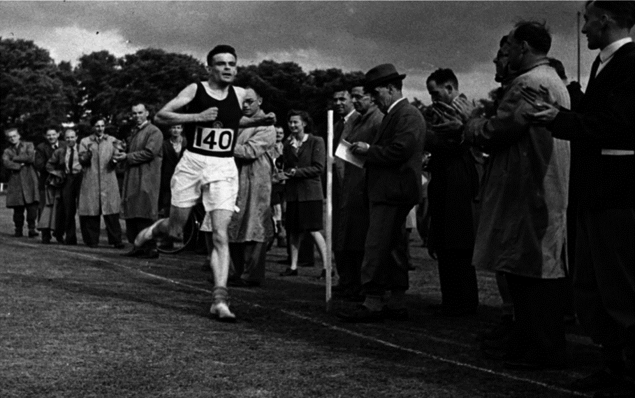
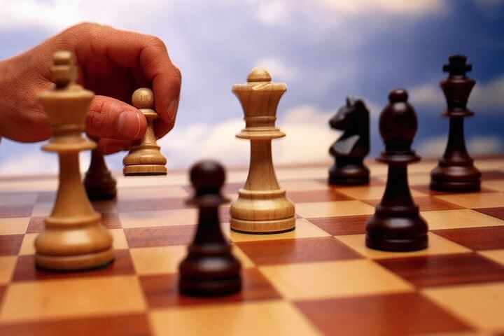
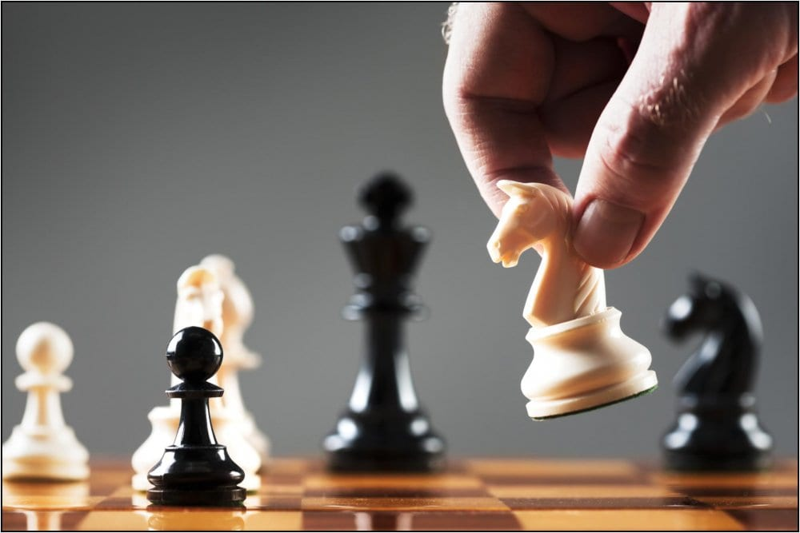
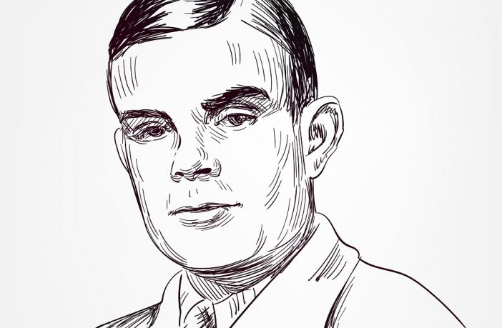
Hobbies
He was an Olympic-level runner
Notes:
3 - Josi

Slide 9



ARTIFICIAL
INTELLIGENCE
The Beginning Of AI
Notes:
Livre

Slide 10
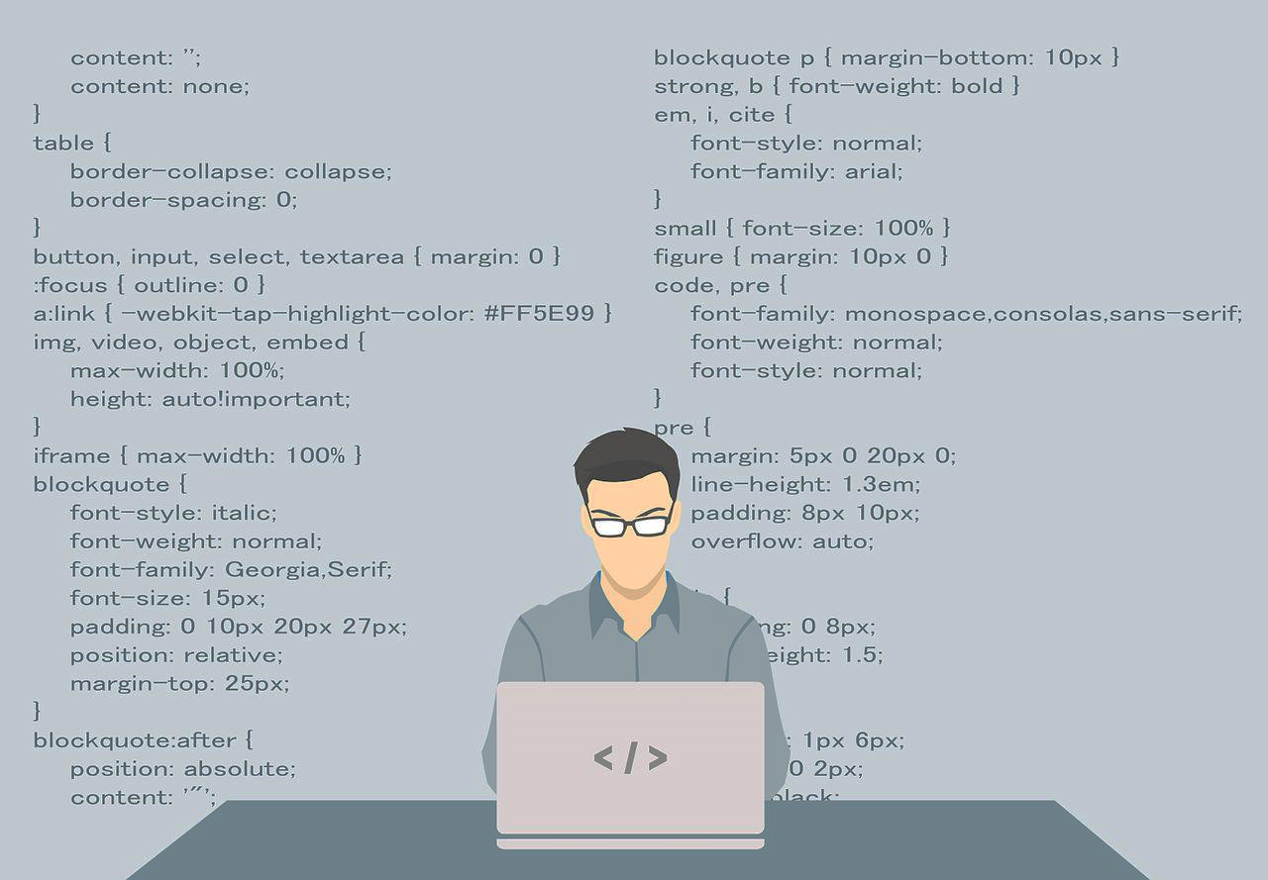


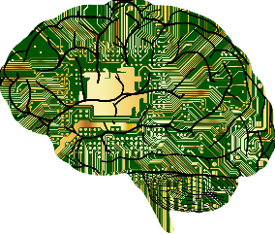




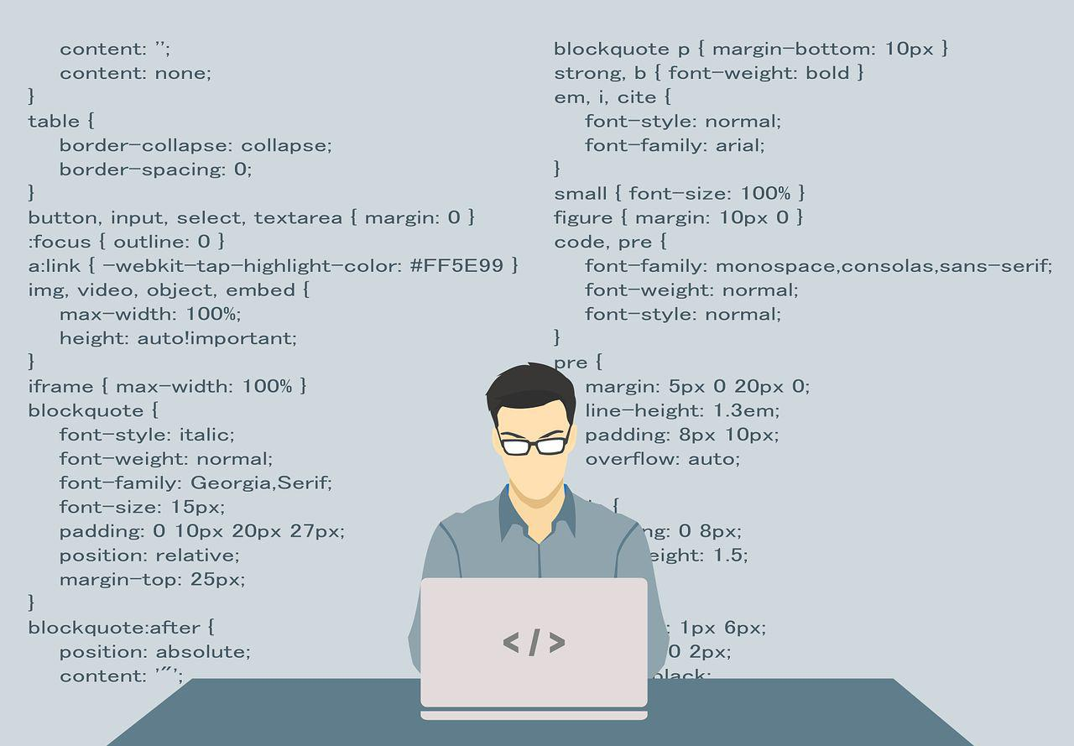
Chess
Problem solving
Notes:
2 - Marcos

Slide 11
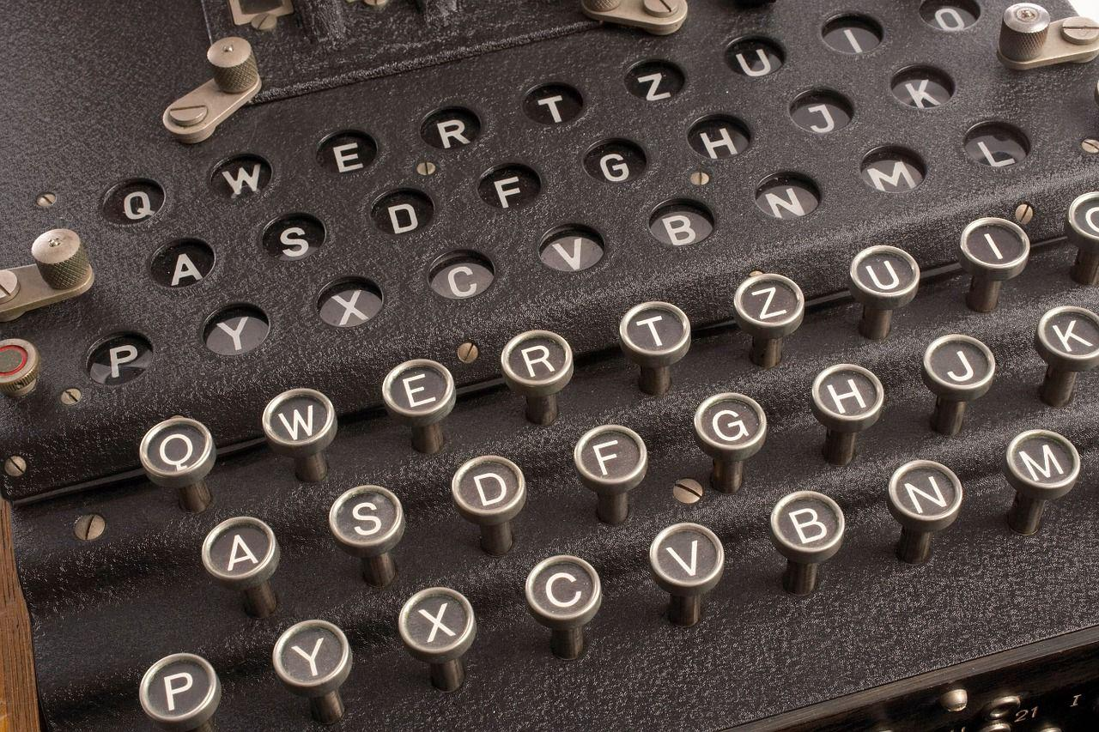



Enigma
Germany
Encode
Decode
nobody know
Notes:
3 - Paty

Slide 12
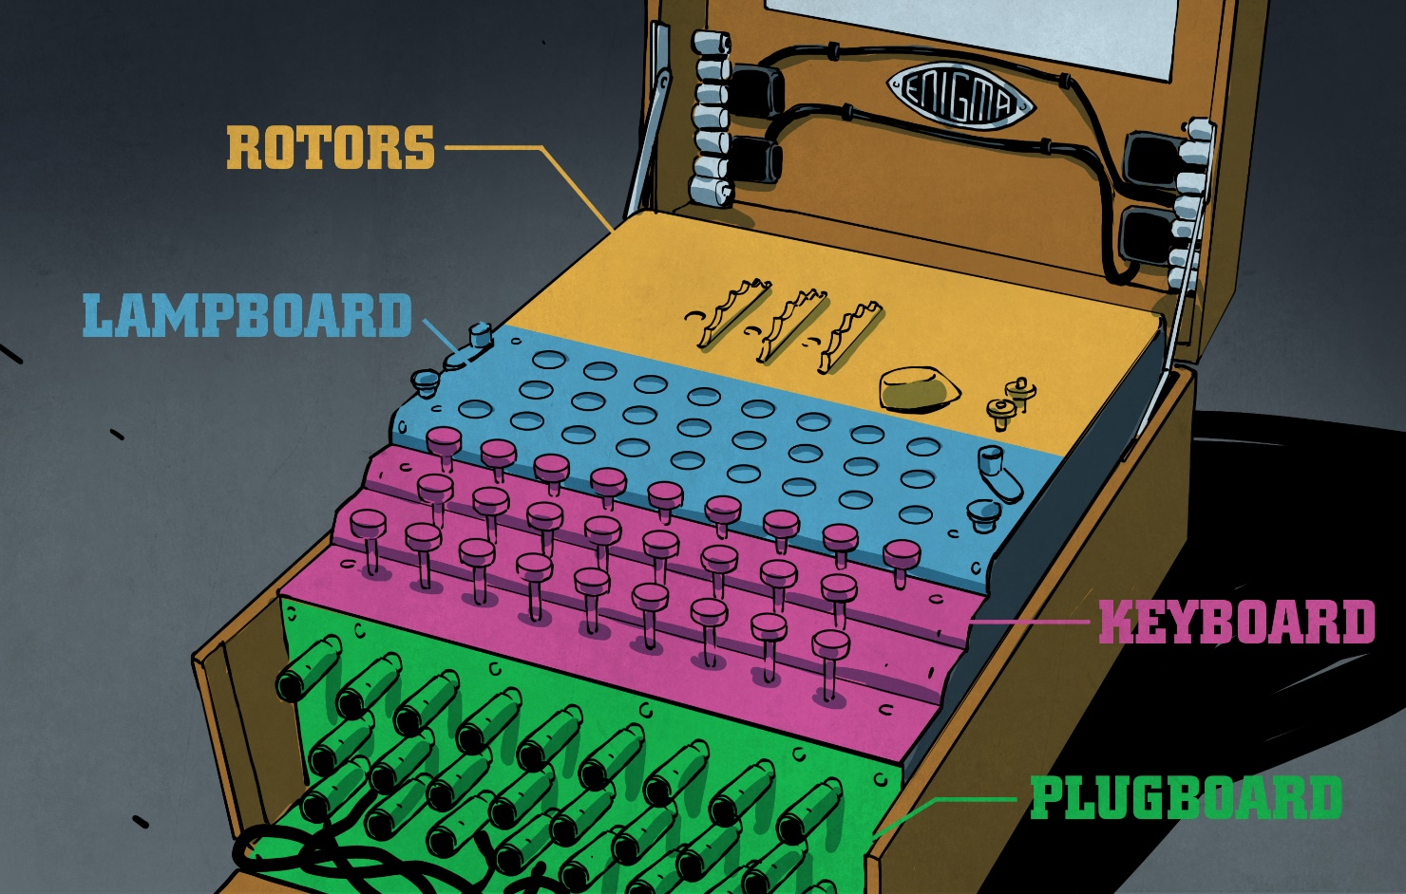
Notes:
4 - Paty

Slide 13


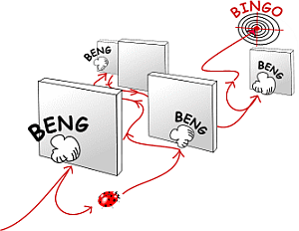
Turing’s Machine
Decode

Slide 14

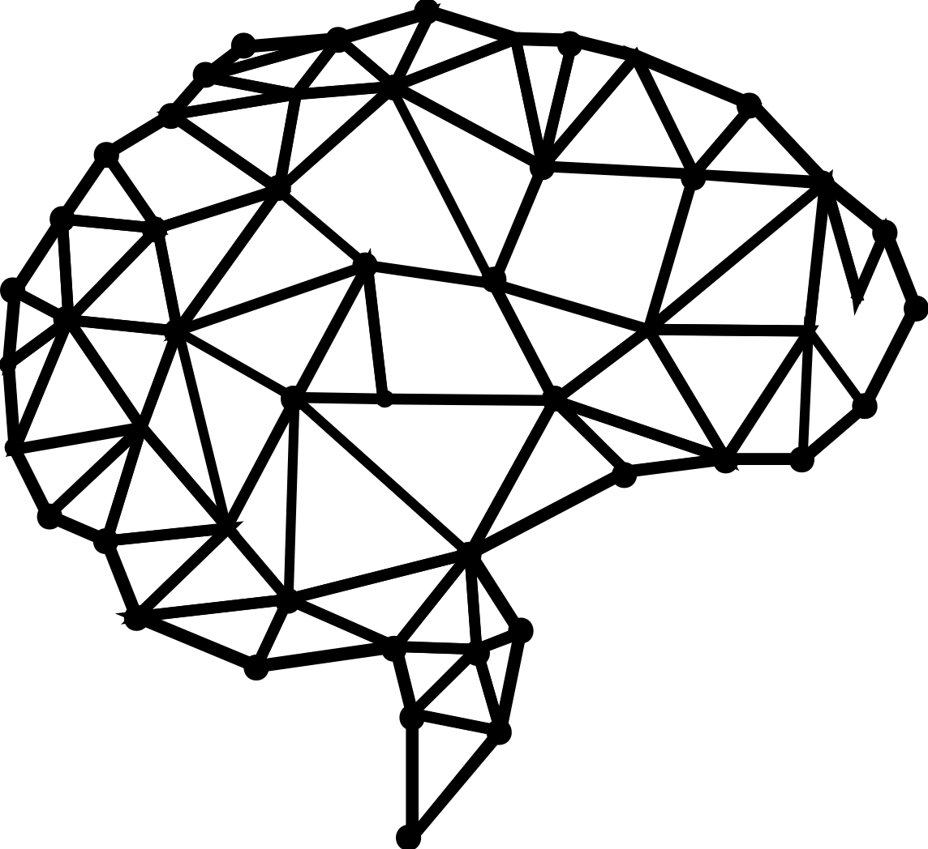
Turing’s Test
“Computing Machinery and Intelligence”
Notes:
5 - Paty

Slide 15

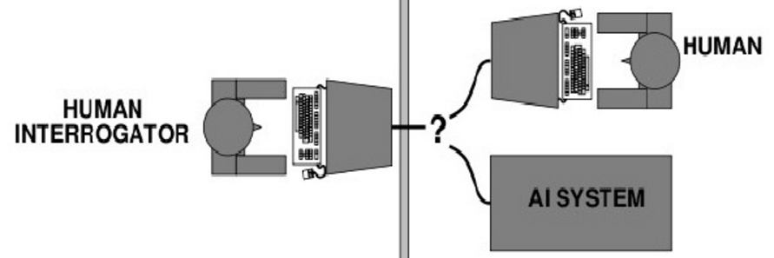
TURING’S TEST
Notes:
6 - Paty

Slide 16
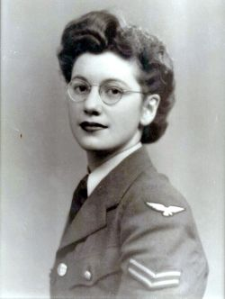
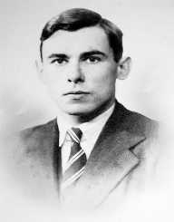
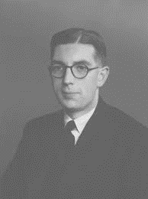

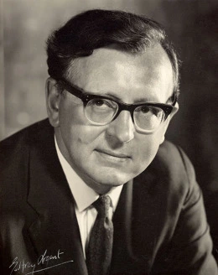
Joan Clarke
Leslie Howarth
Selected People
Nevill Francis Mot
Rodney Hill
(without photo)
Ian Sneddon
(without photo)
James Hardy Wilkinson
Notes:
3 - Marcos

Slide 17
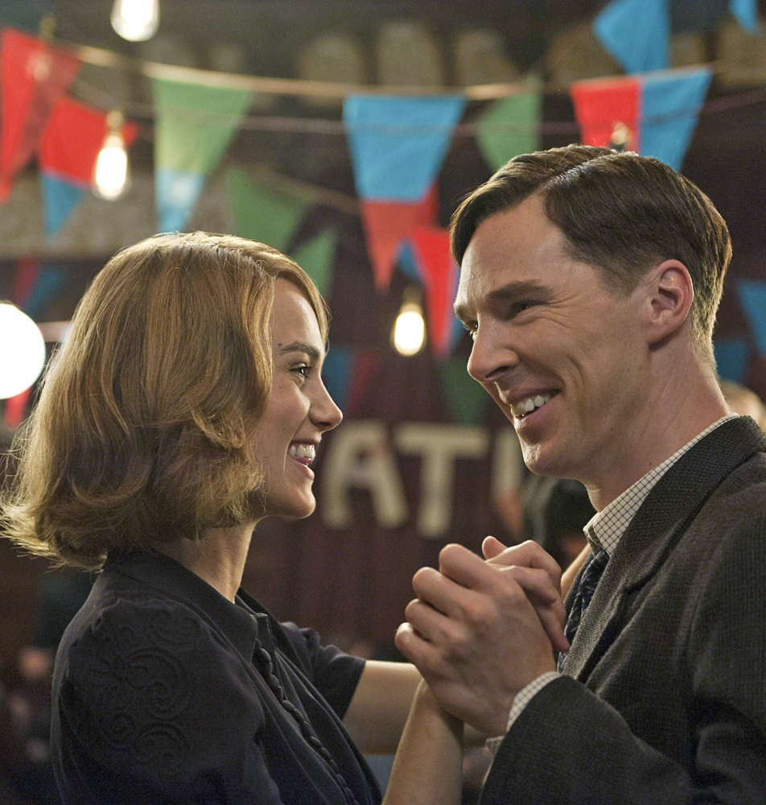

Alan Turing and Joan Clarke
Notes:
4 - Marcos

Slide 18

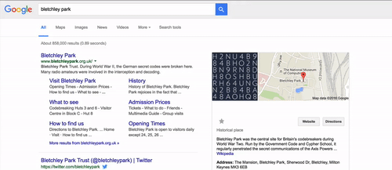
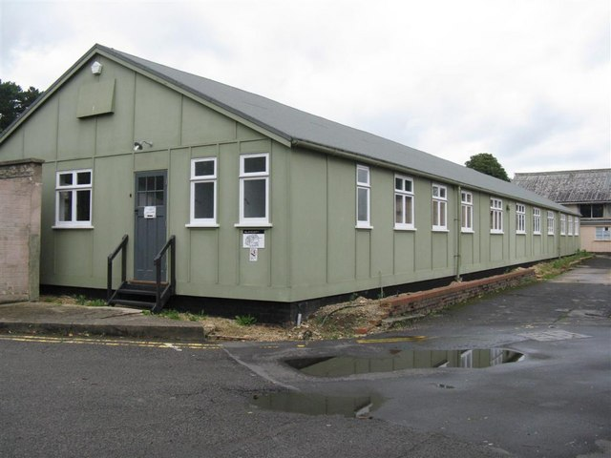
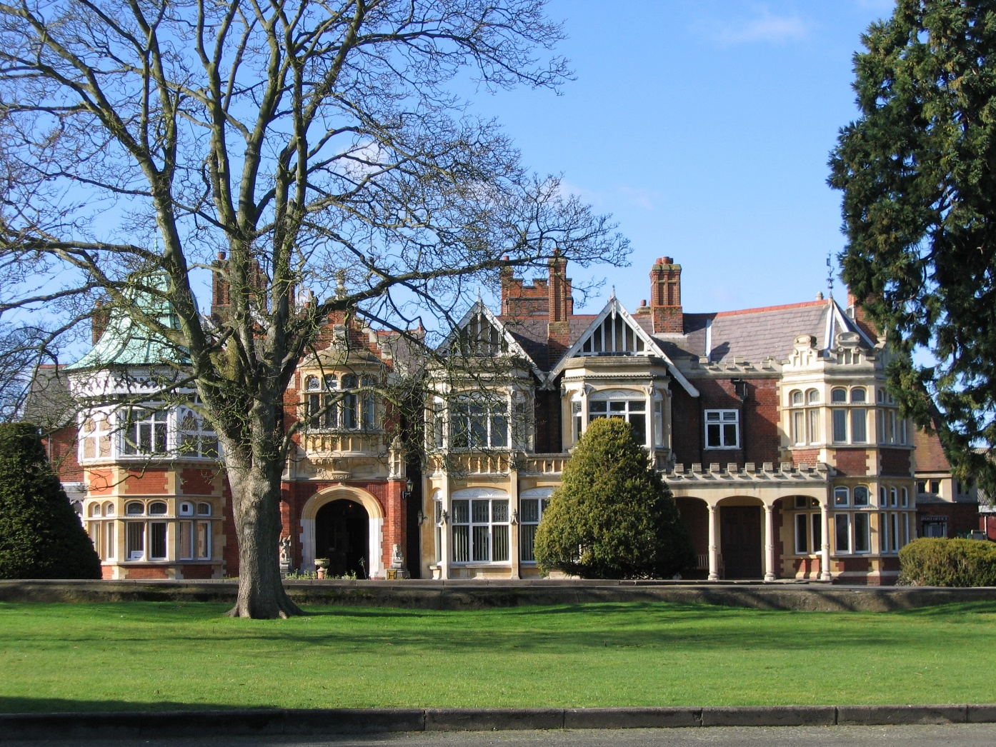
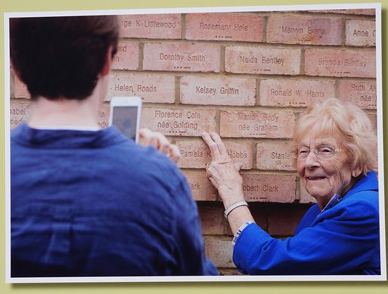
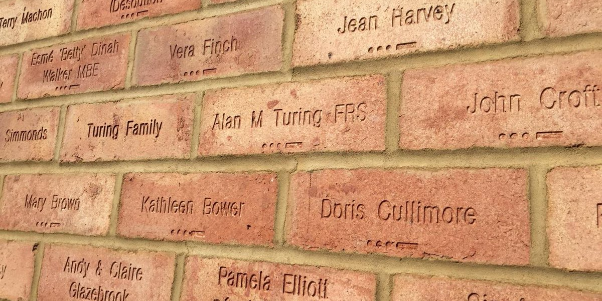
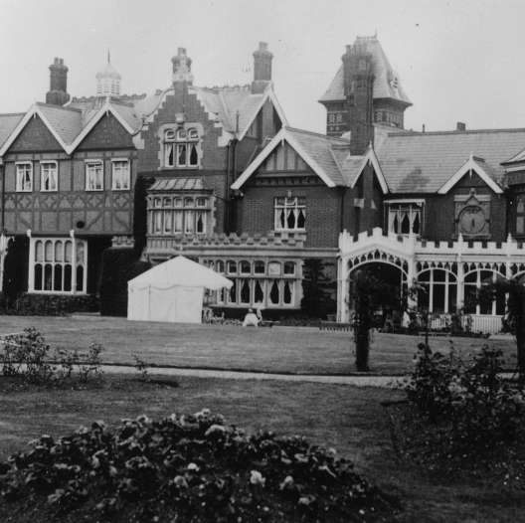
Add Text Here
You can simply impress your audience and add a unique zing and appeal to your Presentations. Get a modern PowerPoint Presentation that is beautifully designed.
Notes:
5 – Marcos/ 7 - Paty

Slide 19
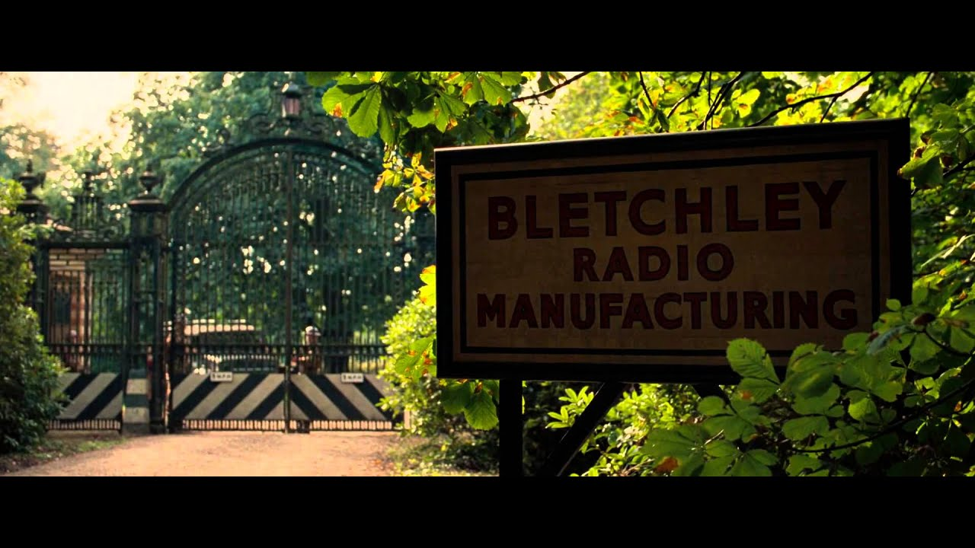

During the Second War
10.000 people worked at the Bletchley Park
7.500 were woman
Notes:
6 - Marcos

Slide 20




Consequences
Christmas
Portfolio Designed
You can simply impress your audience and add a unique zing and appeal to your Presentations. I hope and I believe that this Template will your Time, Money and Reputation.
Notes:
7 - Marcos

Slide 21
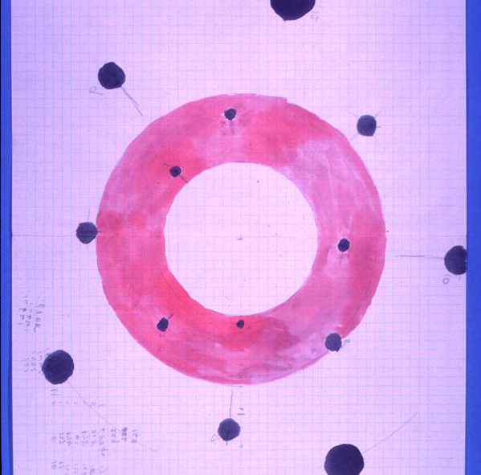
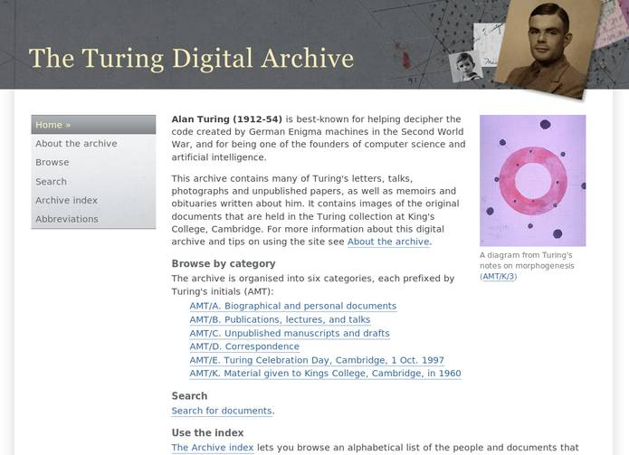
Theory of morphogenesis in plants
Biology
Work
In 1960

Slide 22
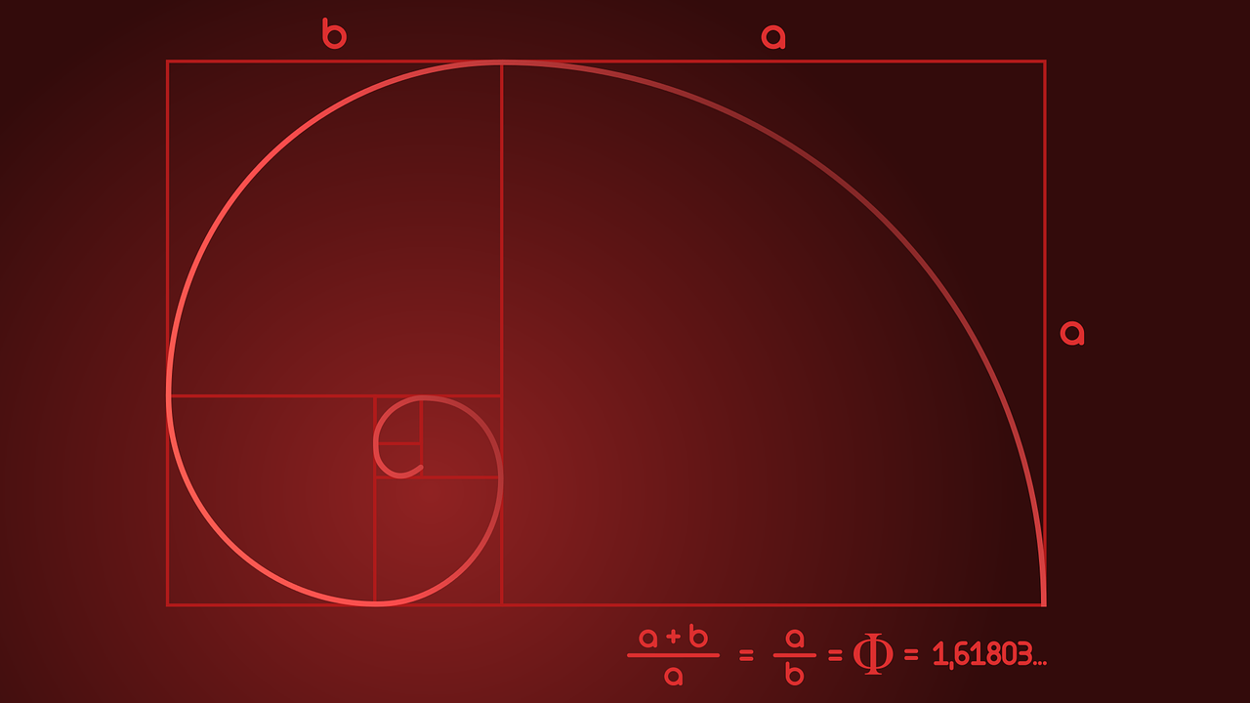
Fibonacci Sequence
Notes:
8 - Paty

Slide 23
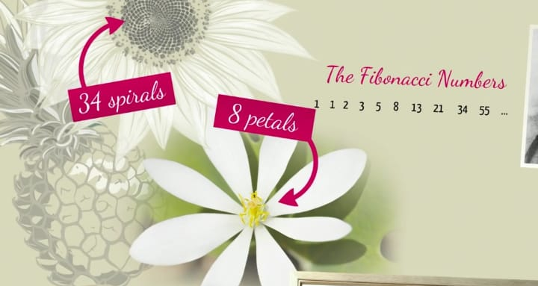
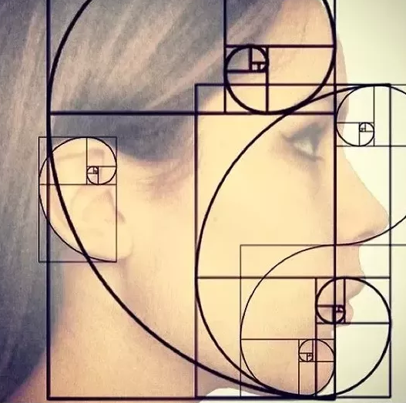

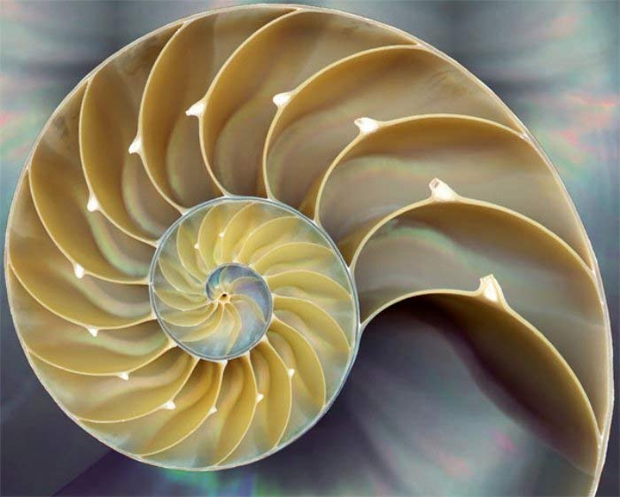
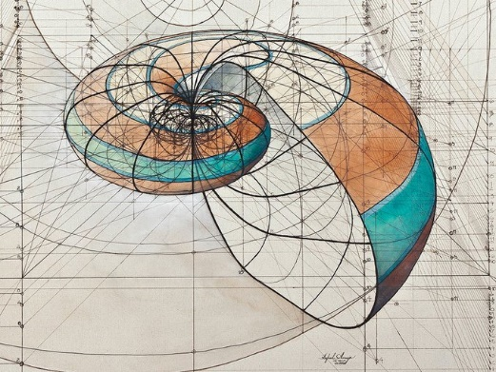
Notes:
9 - Paty

Slide 24

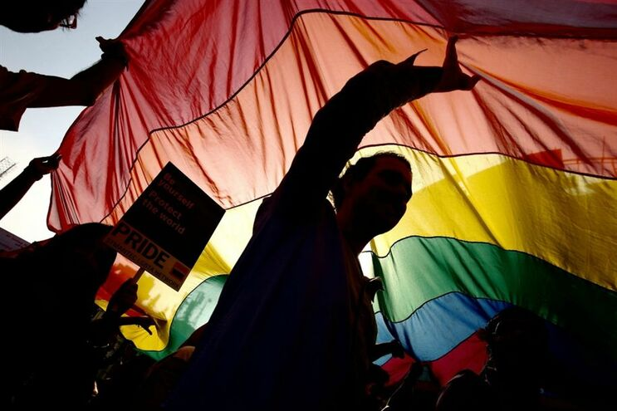

Homosexuality, Conviction and Death Homosexuality was illegal in the United Kingdom in the early 1950s.
Notes:
9 - Marcos

Slide 25
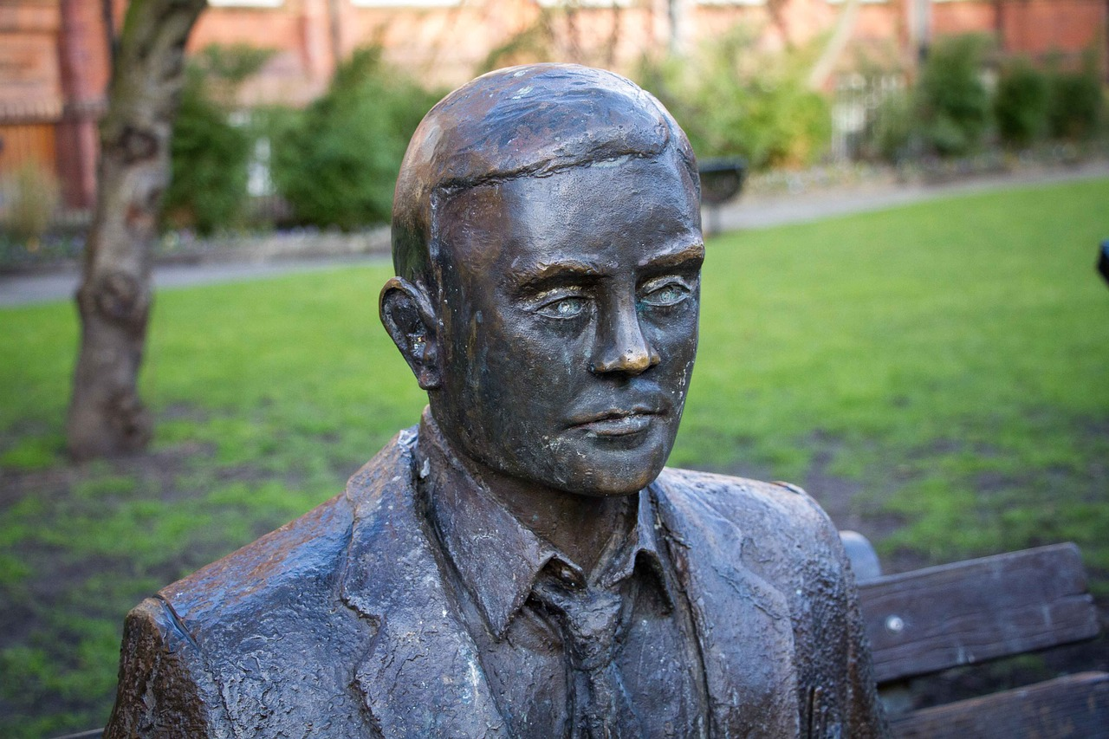

Royal Pardon
Almost 60 years after he committed suicide.
Notes:
10 - Marcos

Slide 26
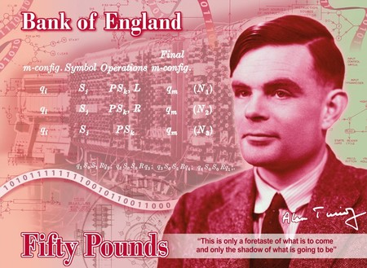
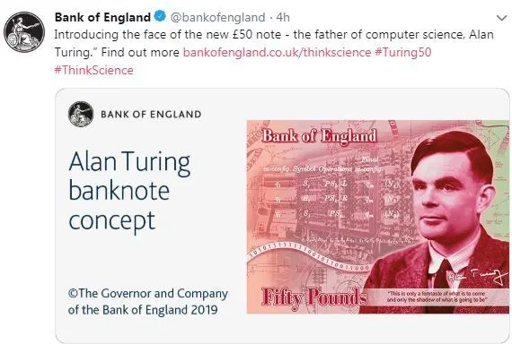
£50 note
Alan Turing
Notes:
11 - Marcos

Slide 27

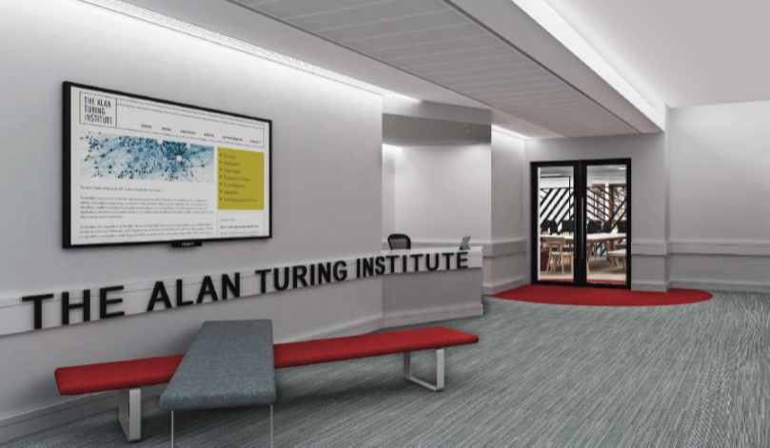
The national institute for data science and artificial intelligence - Research which tackles some of the biggest challenges in science, society and the economy.
Notes:
3 - Josi

Slide 28
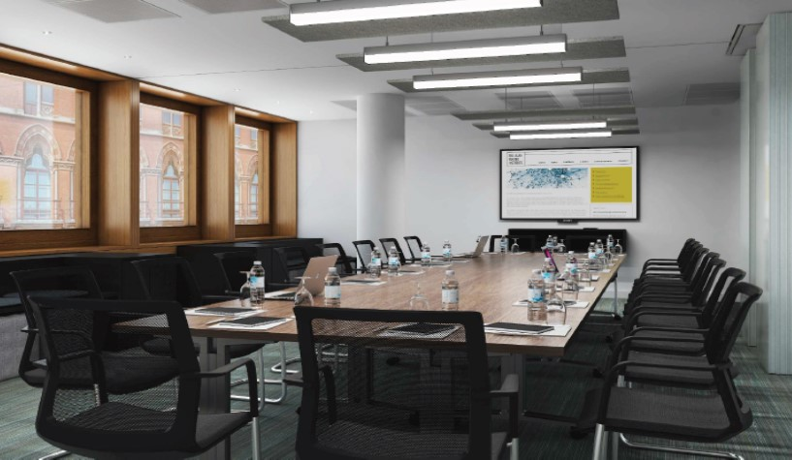
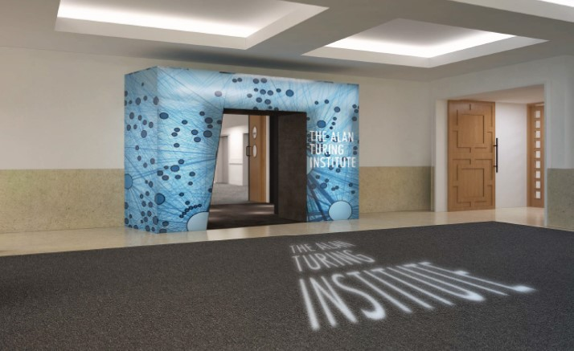
The Institute collaborate with universities, businesses and public and third sector organisations to apply this research to real-world problems, with lasting effects for science, the economy, and the world we live in.
Notes:
4 - Josi

Slide 29
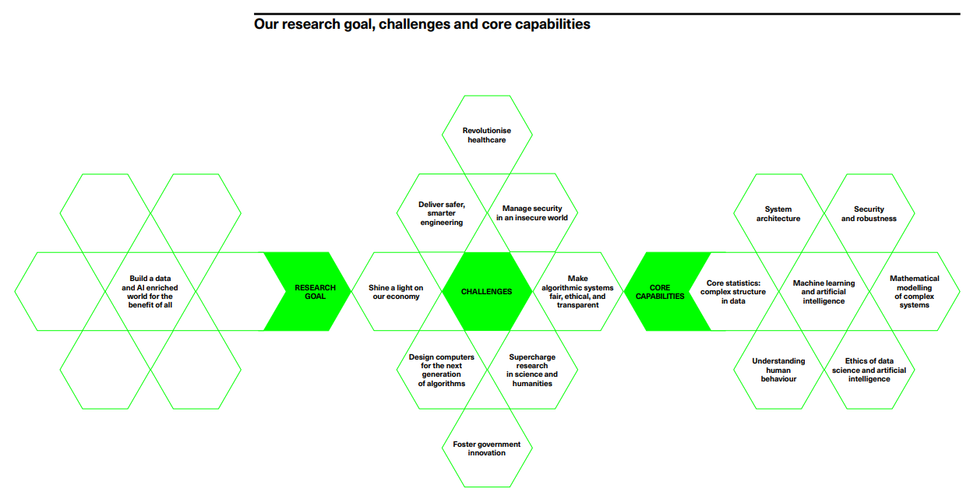
Change the world for the better
Notes:
5 - Josi

Slide 30

Turing
Law
The historic comes after the Policing Crime Bill.
(31 January 2017) – Royal Assent.
Notes:
6 - Josi

Slide 31


MAIN BOOKS
Notes:
7 - Josi

Slide 32


Poisoned Apple
Killed
Notes:
11 - Marcos

Slide 33


Cyanide
One of most powerful poisons
Notes:
12 - Marcos

Slide 34



THANKS!

